Slide 1
Coursera Capstone Project Week -5
PROJECT REPORT
Opening SMALL FAMILLY RESTRAUNT IN TORONTO (CANADA)

Slide 2

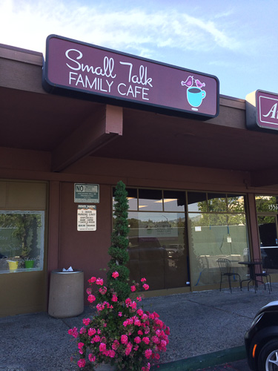
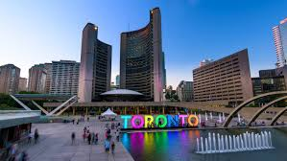

Slide 3
INTRODUCTION
The main goal is to check a concept that there may not be enough Small Family Restaurants in Toronto Area.
Although it might be a great opportunity for a small businesses who is based in Canada in the city Toronto.
As the small restaurants are very popular among family-oriented community, so the businessman might think of opening his/her business in areas where residential areas are located.
Looking for a place to open such a restaurant is one of the most important decisions for the businessman.
This project will help him find the most profitable location.

Slide 4

BUSINESS PROBLEM
To find the most advantageous location for the small business to open a new Small Family Restaurant in Toronto (Canada).

Slide 5
PURPOSE AUDIENCE
The businessman who wants to find the best place to open the Small Family restaurant.

Slide 6
DATA
To solve this task, we will need to use the following data:
● Latitude and Longitude of these neighbourhoods;
● List of neighbourhoods in Toronto( Canada);
● Venue data related to small family restaurants’ location.
This will help us find the neighbourhoods that are more advantageous to open a Small Restaurant.

Slide 7
EXTRACTING THE DATA
● Getting Latitude and Longitude data of these neighbourhoods via Geocoder package;
● The scrapping of Toronto neighborhoods via Wikipedia;
● Using Foursquare API to get venue data related to these neighborhoods.

Slide 8
RESULT CLUSTERS
Cluster 0: Neighbourhoods with the less number of Small Family Restaurants.
Cluster 1: Neighbourhoods with no Family restaurants.
Cluster 2: Neighbourhoods with the most number of Small restaurants

Slide 9
CONCLUSION RECOMMENDATIONS
The most number of the Small Family restaurants are in cluster 2 which is around Central Bay Street, Church and Wellesley, Berczy Park, Union Station, Richmond, the lowest in Cluster 1 areas which are in North Toronto West and Parkade areas. So this is the best place to open one of such kind restaurants.

Slide 10
THANK YOU !

